Slide 1



Thynk Unlimited
Home
About
Content
Others
PARALLEL PROCESSING IN COMPUTER ARCHITECTURE
Lkhagva-Ochir 202339663
Computer Architecture

Slide 2






Thynk Unlimited
Home
About
Content
Others
Contents
Introduction
Operation
Types
Benefits and Challenges
History
Real-World example

Slide 3
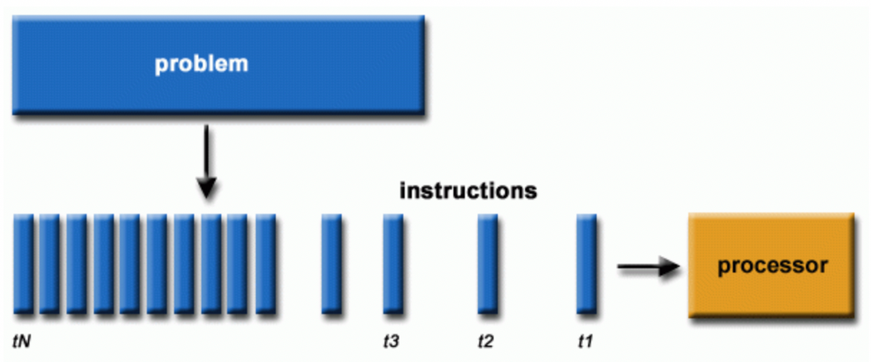
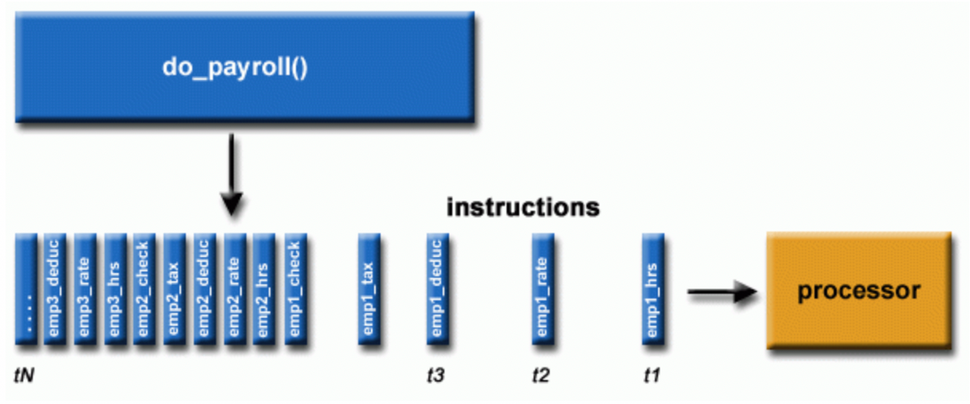
Thynk Unlimited
Home
About
Content
Others
Introduction
Serial computing generic example
Serial computing example of processing payroll

Slide 4
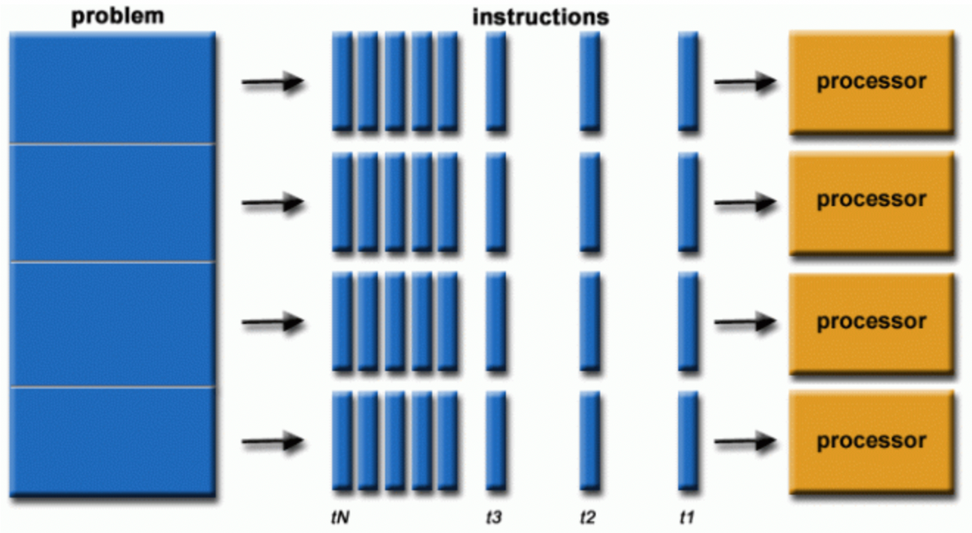

Thynk Unlimited
Home
About
Content
Others
What is Parallel Processing?
Parallel processing is a method in computing of running two or more processors, or CPUs, to handle separate parts of an overall task. Breaking up different parts of a task among multiple processors helps reduce the amount of time it takes to run a program. Multi-core processors, frequently found in modern computers, and any system with more than one CPU are capable of performing parallel processing.
Parallel computing generic example

Slide 5
Thynk Unlimited
Home
About
Content
Others
How it works?
Parallel processing divides a task between two or more microprocessors. Typically, a complex task is divided into multiple parts using a specialized software tool that assigns each part to a processor based on the task's component elements.
Sequential:
Program
CPU
Program
CPU
Task 1
Task 2
Parallel:
CPU (Task 1)
Program
CPU (Task 2)
Result
CPU (Task 3)

Slide 6
Thynk Unlimited
Home
About
Content
Others
Different types of parallel processing
Single Instruction, Single Data (SISD)
Multiple Instruction, Single Data (MISD)
Single Instruction, Multiple Data (SIMD)
Flynn’s Taxonomy:
Multiple Instruction, Multiple Data (MIMD)
Single Program, Multiple Data (SPMD)
Massively Parallel Processing (MPP)

Slide 7
Thynk Unlimited
Home
About
Content
Others
Single Instruction, Single Data (SISD)
A single processor is responsible for simultaneously managing a single algorithm as a single data source. A computer organization having a control unit, a processing unit, and a memory unit is represented by SISD.
2. Multiple Instruction, Single Data (MISD)
Multiple processors are standard in computers that use the Multiple Instruction, Single Data (MISD) instruction set. While using several algorithms, all processors share the same input data. MISD computers can simultaneously perform many operations on the same batch of data.
3. Single Instruction, Multiple Data (SIMD)
Computers that use the Single Instruction, Multiple Data (SIMD) architecture have multiple processors that carry out identical instructions. However, each processor supplies the instructions with its unique collection of data. SIMD computers apply the same algorithm to several data sets. The SIMD architecture has numerous processing components.

Slide 8
Thynk Unlimited
Home
About
Content
Others
4. Multiple Instruction, Multiple Data (MIMD)
Multiple Instruction, Multiple Data, or MIMD, computers are characterized by the presence of multiple processors, each capable of independently accepting its instruction stream. These kinds of computers have many processors. Additionally, each CPU draws data from a different data stream. A MIMD computer is capable of running many tasks simultaneously.
5. Single Program, Multiple Data (SPMD)
SPMD systems are a subset of MIMD. Although an SPMD computer is constructed similarly to a MIMD, each of its processors is responsible for carrying out the same instructions.
6. Massively Parallel Processing (MPP)
A storage structure called Massively Parallel Processing (MPP) is made to manage the coordinated execution of program operations by numerous processors. With each CPU using its operating system and memory, this coordinated processing can be applied to different program sections.

Slide 9
Thynk Unlimited
Home
About
Content
Others
Benefits
Increased Speed and Efficiency: | By dividing tasks into smaller parts and executing them concurrently, parallel processing significantly reduces overall execution time, leading to faster results.
Enhanced Performance: | Parallel processing can improve the performance of applications, especially those that involve large datasets or complex calculations, such as scientific simulations, machine learning, and data analysis.
Improved Responsiveness: | Parallel processing can make applications more responsive, especially in scenarios where multiple tasks need to be handled simultaneously, such as in graphical user interfaces (GUIs).
Scalability: | Parallel processing allows for easier scaling of applications and systems by adding more processors or cores, enabling them to handle larger workloads.

Slide 10
Thynk Unlimited
Home
About
Content
Others
Challenges
Increased Complexity: | Designing, implementing, and debugging parallel programs can be significantly more complex than writing sequential code.
Debugging and Testing: | Parallel programs can be harder to debug and test because the execution order of different threads or processes is not always predictable, making it difficult to identify and fix issues.
Synchronization issues: | Coordinating and synchronizing multiple threads or processes, and managing data sharing and communication between them, can introduce overhead and reduce overall performance.
Energy Consumption: | Parallel systems can consume more power than their serial counterparts, especially when running at full capacity.

Slide 11
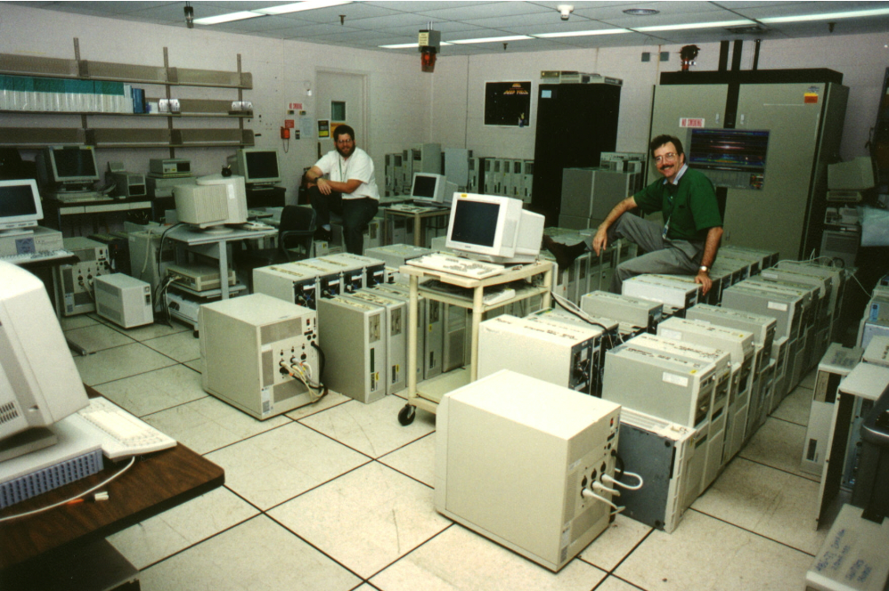
Thynk Unlimited
Home
About
Content
Others
History
Parallel computing began in the late 1950s and evolved through shared memory multiprocessors in the 1960s and 70s. A major milestone occurred in the 1980s when Caltech demonstrated high performance using standard microprocessors. This led to the rise of massively parallel processors (MPPs), which became dominant in high-performance computing. A key breakthrough came in 1997 with the ASCI Red supercomputer, the first to exceed one trillion operations per second. Since then, MPPs have continued to advance in scale and capability.
A Beowulf Cluster - A collection of computers in a local area network, allowing shared processing of tasks.

Slide 12



Thynk Unlimited
Home
About
Content
Others
Real-World example
Supercomputers for use in astronomy
When examining the Universe phenomena such as Galaxy Formation, Planetary Movements, Climate Change, etc, computer simulations are essential since the ingestions can take millions of years.
Galaxy Formation
Planetary Movements
Climate Change
Real world phenomena can be simulated with parallel computing

Slide 13
Thynk Unlimited
Home
About
Content
Others
THANK YOU
www.reallygreatsite.com

